Slide 1
Behaviour Driven Development : theGardener roots

Slide 2
BDD : theGardener roots
Introduction
Full BDD example on a library
Improve the process with theGardener
Conclusion
<number>

Slide 3
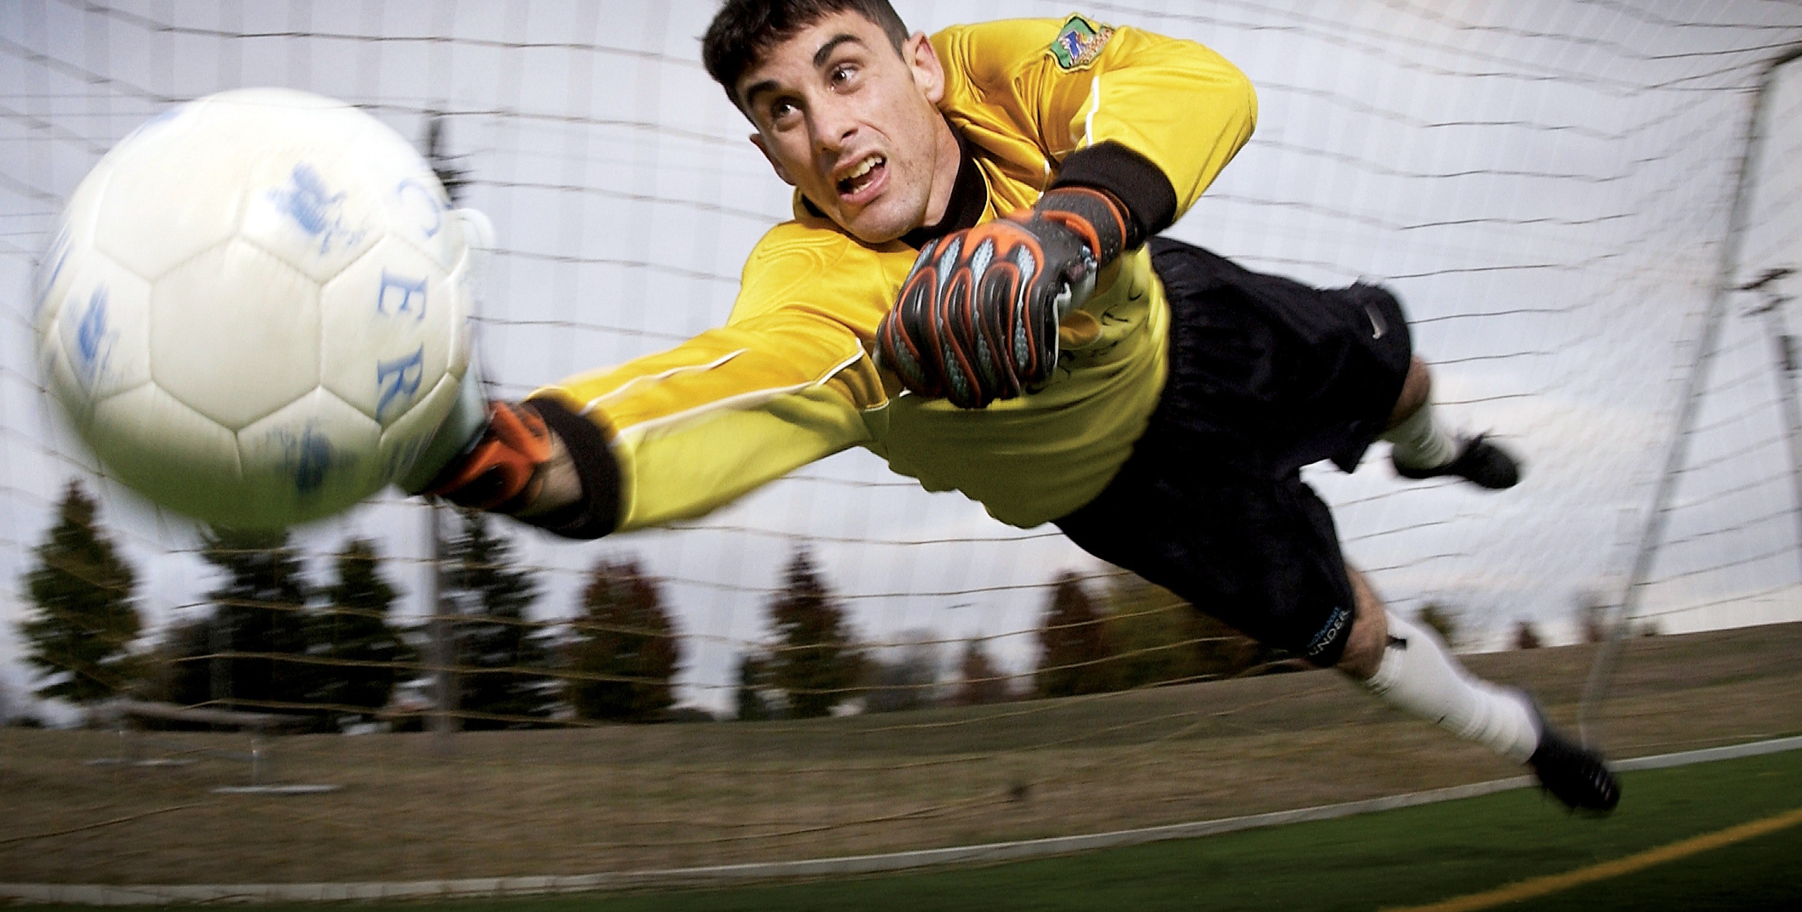
Introduction
Goal : make you want to try or try the BDD again
<number>

Slide 4

Introduction
A product owner during the demo of the product after an iteration
<number>

Slide 5
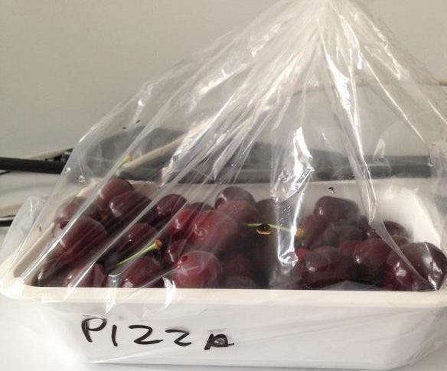
Introduction
Functional documentation after many iterations and readjustments of the need
<number>

Slide 6

Introduction
Functional tests that flash
Non-exhaustive functional tests
<number>

Slide 7
Introduction
Behavior
Driven Development
Specification by example
Functional
tests
Executable documentation
<number>

Slide 8
Introduction | Specification by an example
Scenario: suggested suggestions are popular, available and adapted to the age of the user
Given the user "Tim"
and he is "4" years old
and the popular categories for this age are
| categoryId | name |
| cat1 | Walt Disney |
| cat2 | Bedtime stories |
and the available books for those categories are
| bookId | bookTitle | categoryId |
| lv11 | Peter Pan | cat1 |
| lv21 | The tortoise and the hare | cat2 |
When we ask for "2" suggestions
Then the suggestions are
| bookId | bookTitle | categoryId |
| lv11 | Peter Pan | cat1 |
| lv21 | The tortoise and the hare | cat2 |
<number>

Slide 9

Introduction | Functional tests
suggestions
WebService
suggestions
Reports
CATEGORIES
SUGGESTIONS
SEARCH
suggestions
Cache
SLOW
HARD
Between systems
On a system between components
BDD
FAST
EASY
On a component
On a class
<number>

Slide 10
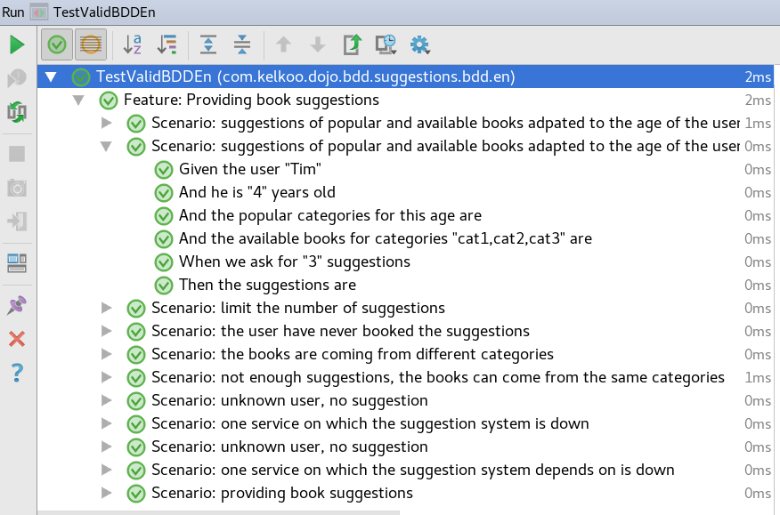
Introduction | Functional tests
<number>

Slide 11
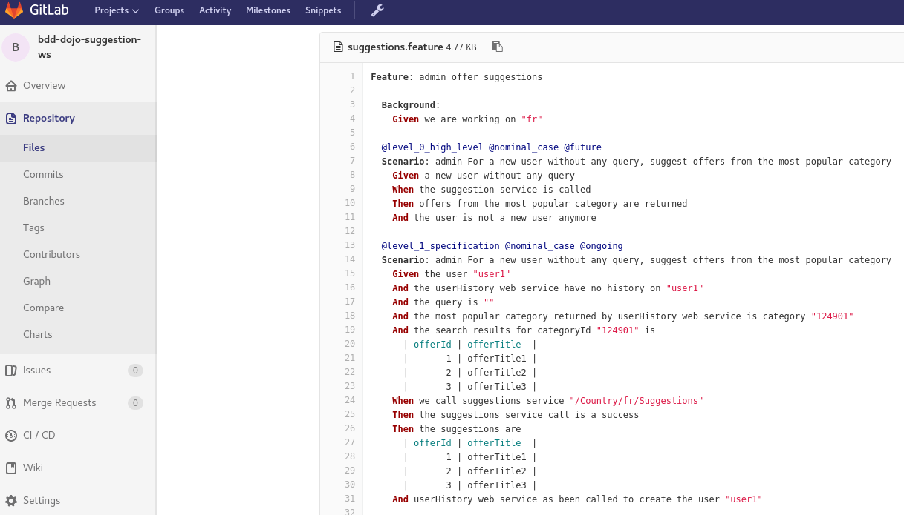
Introduction | Executable Documentation
<number>

Slide 12
Library | User Story to be implemented
PO
DEV
<number>

Slide 13
Library | User Story to be implemented
CATEGORIES
USERS
Categories of books, popular categories by age
Users, ages, books already red...
User
SUGGESTIONS
BOOKING
Provides book suggestions
SEARCH
Booking service,
Available books
Provides books, textual search,
multi-criteria search
(category, popularity, availability ...)
<number>

Slide 14
Library | User Story to be implemented
As a user of the library,
I wish to book suggestions
to make discoveries
Acceptance criteria :
Book not read by the user
Book available
<number>

Slide 15
Library | User Story to be implemented
PO
User Story
As a user of the library, I wish to book suggestions to make discoveries
Suggestions must be appropriate to the age of
the user
For a better discovery, the books must come from different categories
<number>

Slide 16
Library | User Story to be implemented
DEV
User Story
As a user of the library, I wish to book suggestions to make discoveries
Focus on how to recover books, forgets that the book must be unread by the user
The simplest way : research
the popularity of books
<number>

Slide 17
Library | Write scenarios in collaboration
PO
Scenario: provide book suggestions
Given a user
When we ask for suggestions
Then the suggestions are popular and
available books adapted to the age of the user
Missing example!
<number>

Slide 18
Library | Write scenarios in collaboration
Scenario: suggested suggestions are popular, available
and adapted to the age of the user
Given the user from http://my.library.com/user/Tim | field | value | | userId | Tim | | age | 4 | And the categories from http://my.library.com/category?popular=true&age=4 | categoryId | categoryName | | cat1 | Walt Disney | | cat2 | Picture books | | cat3 | Bedtime stories | And the books from http://my.library.com/search?categories=cat1,cat2,cat3&available=true | bookId | bookTitle | categoryId | | b11 | Peter Pan | cat1 | | b21 | Picture book about farm | cat2 | | b31 | The tortoise and the hare | cat3 | And the books from http://my.library.com/user/Tim/books | bookId | bookTitle | categoryId | | b11 | Peter Pan | cat1 | When we call http://localhost:9998/suggestions?userId=Tim&maxResults=3 Then the http code is "200" Then the suggestions are | bookId | bookTitle | categoryId | | b21 | Picture book about farm | cat2 | | b31 | The tortoise and the hare | cat3 |
PO
DEV
Too technical, I don’t understand
Non-speaking example
Not linked to the user
Missing limit number of suggestions
<number>

Slide 19
Library | Write scenarios in collaboration
Scenario: provide book suggestions
Given the user "Tim"
And he is "4" years old
And the popular categories for this age are
| categoryId | name |
| cat1 | Walt Disney |
| cat2 | Picture books |
| cat3 | Bedtime stories |
And the available books for categories "cat1,cat2,cat3" are
| bookId | title | categoryId |
| lv11 | Peter Pan | cat1 |
| lv21 | Picture book about farm | cat2 |
| lv31 | The tortoise and the hare | cat3 |
When we ask for "3" suggestions
Then the suggestions are
| bookId | title | categoryId |
| lv11 | Peter Pan | cat1 |
| lv21 | Picture book about farm | cat2 |
| lv31 | The tortoise and the hare | cat3 |
PO
DEV
Missing limit number of suggestions
Missing : never read
Missing : different categories
<number>

Slide 20
Library | Write scenarios in collaboration
Scenario: provide book suggestions
Given the user "Tim"
And he is "4" years old
And the popular categories for this age are
| categoryId | name |
| cat1 | Walt Disney |
| cat2 | Picture books |
| cat3 | Bedtime stories |
And the available books for categories "cat1,cat2,cat3" are
| bookId | title | categoryId |
| lv11 | Peter Pan | cat1 |
| lv21 | Picture book about farm | cat2 |
| lv31 | The tortoise and the hare | cat3 |
When we ask for suggestions
Then the suggestions are
| bookId | title | categoryId |
| lv11 | Peter Pan | cat1 |
| lv21 | Picture book about farm | cat2 |
PO
DEV
Missing : never read
“2”
Limit number of suggestions
<number>

Slide 21
Library | Write scenarios in collaboration
Scenario: provide book suggestions
Given the user "Tim"
And he is "4" years old
And the popular categories for this age are
| categoryId | name |
| cat1 | Walt Disney |
| cat2 | Picture books |
| cat3 | Bedtime stories |
And the available books for categories "cat1,cat2,cat3" are
| bookId | title | categoryId |
| lv11 | Peter Pan | cat1 |
| lv12 | Pinocchio | cat1 |
| lv21 | Picture book about farm | cat2 |
| lv31 | The tortoise and the hare | cat3 |
When we ask for suggestions
Then the suggestions are
| bookId | title | categoryId |
| lv11 | Peter Pan | cat1 |
| lv21 | Picture book about farm | cat2 |
PO
DEV
Missing : never read
4
“2”
different categories
<number>

Slide 22
Library | Write scenarios in collaboration
Scenario: provide book suggestions
Given the user "Tim"
And he is "4" years old
And the popular categories for this age are
| categoryId | name |
| cat1 | Walt Disney |
| cat2 | Picture books |
| cat3 | Bedtime stories |
And the available books for categories "cat1,cat2,cat3" are
| bookId | title | categoryId |
| lv11 | Peter Pan | cat1 |
| lv12 | Pinocchio | cat1 |
| lv13 | Bamby | cat1 |
| lv21 | Picture book about farm | cat2 |
| lv31 | The tortoise and the hare | cat3 |
And the user has already booked the following books
| bookId | title | categoryId |
| lv11 | Peter Pan | cat1 |
When we ask for suggestions
Then the suggestions are
| bookId | title | categoryId |
| lv21 | Picture book about farm | cat2 |
| lv31 | The tortoise and the hare | cat3 |
PO
DEV
What are we testing ? Prefer several scenario
“2”
Never read
<number>

Slide 23
Library | Write scenarios in collaboration
Scenario: suggested suggestions are popular, available
and adapted to the age of the user
Given the user "Tim"
And he is "4" years old
And the popular categories for this age are
| categoryId | name |
| cat1 | Walt Disney |
| cat2 | Picture books |
And the available books for categories "cat1,cat2" are
| bookId | title | categoryId |
| lv11 | Peter Pan | cat1 |
| lv21 | Picture book about farm | cat2 |
When we ask for "2" suggestions
Then the suggestions are
| bookId | title | categoryId |
| lv11 | Peter Pan | cat1 |
| lv21 | Picture book about farm | cat2 |
PO
DEV
Scenario 1 : nominal case
=> minimal
<number>

Slide 24
Library | Write scenarios in collaboration
Scenario: limit number of suggestions
Given the user "Tim"
And he is "4" years old
And the popular categories for this age are
| categoryId | name |
| cat1 | Walt Disney |
| cat2 | Picture books |
And the available books for categories "cat1,cat2" are
| bookId | title | categoryId |
| lv11 | Peter Pan | cat1 |
| lv21 | Picture book about farm | cat2 |
When we ask for “1" suggestions
Then the suggestions are
| bookId | title | categoryId |
| lv11 | Peter Pan | cat1 |
PO
DEV
Scenario 2 : nominal case
Simplify it again !
<number>

Slide 25
Library | Write scenarios in collaboration
Scenario: limit number of suggestions
Given a user
And "3" books are available in popular categories
adapted to his age
When we ask for "2" suggestions
Then "2" suggestions are proposed
among the previous books
PO
DEV
Scenario 2 : nominal case
<number>

Slide 26
Library | Write scenarios in collaboration
Scenario: the user has never red the books that are suggested
Given the user "Tim"
And he is "4" years old
And the popular categories for this age are
| categoryId | name |
| cat1 | Walt Disney |
| cat3 | Bedtime stories |
And the available books for categories "cat1,cat3" are
| bookId | title | categoryId |
| lv11 | Peter Pan | cat1 |
| lv31 | The tortoise and the hare | cat3 |
And the user has already booked the following books
| bookId | title | categoryId |
| lv11 | Peter Pan | cat1 |
When we ask for "1" suggestions
Then the suggestions are
| bookId | title | categoryId |
| | | |
| lv31 | The tortoise and the hare | cat3 |
PO
DEV
Scenario 3 : nominal case
Roll out the algorithm
<number>

Slide 27
Library | Write scenarios in collaboration
Scenario: suggested books come from different categories
Given the user "Tim"
And he is "4" years old
And the popular categories for this age are
| categoryId | name |
| cat1 | Walt Disney |
| cat3 | Bedtime stories |
And the available books for categories "cat1,cat3” are
| bookId | title | categoryId |
| lv11 | Peter Pan | cat1 |
| lv12 | Pinocchio | cat1 |
| lv31 | The tortoise and the hare | cat3 |
When we ask for "2" suggestions
Then the suggestions are
| bookId | title | categoryId |
| lv11 | Peter Pan | cat1 |
| | | |
| lv31 | The tortoise and the hare | cat3 |
PO
DEV
Scenario 4 : nominal case
Roll out the algorithm
<number>

Slide 28
Library | Write scenarios in collaboration
Scenario: if there is not enough suggestions,
we can propose books from the same categories
Given the user "Tim"
And he is "4" years old
And the popular categories for this age are
| categoryId | name |
| cat1 | Walt Disney |
And the available books for categories "cat1,cat3 are
| bookId | title | categoryId |
| lv11 | Peter Pan | cat1 |
| lv12 | Pinocchio | cat1 |
When we ask for "2" suggestions
Then the suggestions are
| bookId | title | categoryId |
| lv11 | Peter Pan | cat1 |
| lv12 | Pinocchio | cat1 |
PO
DEV
Scenario 5 : limit case
Roll out the algorithm
<number>

Slide 29
Library | Write scenarios in collaboration
Scenario: unknown user, no suggestion
Given the user "Lise"
And the user is unknown
When we ask for "3" suggestions
Then there is non suggestions
PO
DEV
Scenario 6 : limit case
<number>

Slide 30
Library | Write scenarios in collaboration
Scenario: one service on which the suggestion system
depends on is down
Given the use "Tim"
And impossible to get information on the user
When we ask for "3" suggestions
Then the system is temporary not available
PO
DEV
Scenario 7 : error case
<number>

Slide 31
Library | Write scenarios in collaboration
Scenario: suggested suggestions are popular, available
and adapted to the age of the user
Given the user from http://my.library.com/user/Tim | field | value | | userId | Tim | | age | 4 | And the categories from http://my.library.com/category?popular=true&age=4 | categoryId | categoryName | | cat1 | Walt Disney | | cat2 | Picture books | | cat3 | Bedtime stories | And the books from http://my.library.com/search?categories=cat1,cat2,cat3&available=true | bookId | bookTitle | categoryId | | b11 | Peter Pan | cat1 | | b21 | Picture book about farm | cat2 | | b31 | The tortoise and the hare | cat3 | And the books from http://my.library.com/user/Tim/books | bookId | bookTitle | categoryId | | b11 | Peter Pan | cat1 | When we call http://localhost:9998/suggestions?userId=Tim&maxResults=3 Then the http code is "200" Then the suggestions are | bookId | bookTitle | categoryId | | b21 | Picture book about farm | cat2 | | b31 | The tortoise and the hare | cat3 |
PO
DEV
Scenario 1 technichal version
<number>

Slide 32
Library | Organize scenarios
As a user of the library,
I wish to book suggestions
to make discoveries
PO
DEV
Scenario 1
Scenario 2
Scenario 0
Scenario 5
Scenario 7
Scenario 3
Scenario 4
Scenario 6
Scenario 7
Scenario 1
<number>

Slide 33
Library | Organize scenarios
As a user of the library,
I wish to book suggestions
to make discoveries
PO
DEV
@nominal_case
@limit_case
@error_case
@level_0_ high_level
Scenario 0
@level_1_ specification
Scenario 1
Scenario 5
Scenario 7
Scenario 2
Scenario 6
Scenario 3
@level_2_ technical
Scenario 1
Scenario 7
<number>

Slide 34
Library | Without specification by example
User Story
Suggestions should be linked to the user !
Acceptance Criteria
PO
Demo
Implementation
Implementation
DEV
Implementation
DEV
<number>

Slide 35
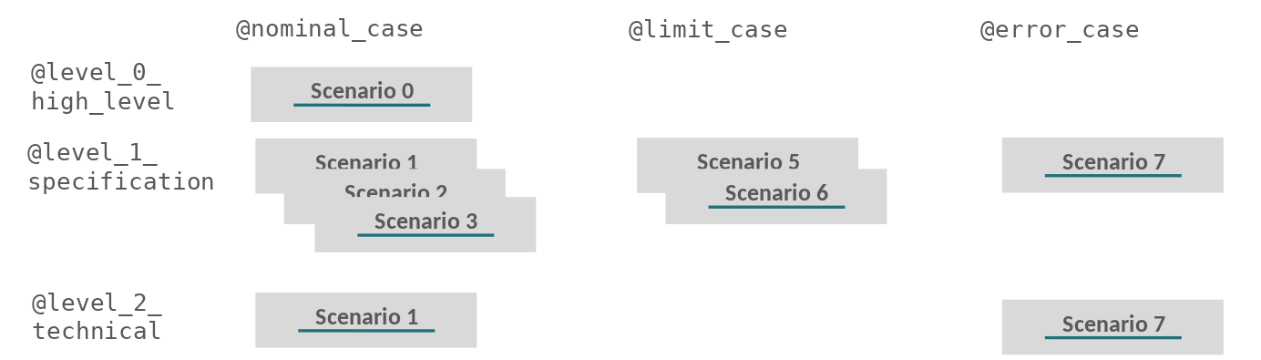
Library | Sprint roadmap
User Story
Acceptance Criteria
2 or 3
hours
Write scenario
PO
PO
DEV
DEV
Demo
3 weeks
BDD
DEV
@level_2
BDD
@level_1
DEV
BDD
<number>

Slide 36
Library | Development cycles
Make scenario
executable
Write
a test
DEV
Refactor at class level
Scenario validated
TDD
Main code
changes
BDD
TDD
Refactoring at component level
TDD
TDD
<number>

Slide 37
Library | Make scenario executable
DEV
Categories
Users
Suggestions
User
Name
Available books
by category
Popular categories by age
Booking
Suggestions
Search
Available books by category
<number>

Slide 38
Library | Make scenario runnable
DEV
Categories
Users
When
Html call
Booking
Mock
Mock
Mock
Search
Suggestions
Then
Checks
Run
Contextual
variables
Main code
Glue code for BDD
Given
<number>

Slide 39
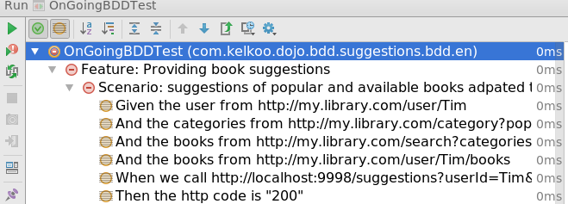
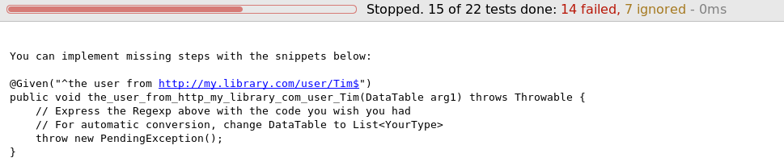
Library | Make scenario runnable
@level_2_technical_details @nominal_case @ongoing
Scenario: suggestions of popular and available books adapted to the age of the user, he have never booked suggestions
Given the user from http://my.library.com/user/Tim
| field | value |
| userId | Tim |
| age | 4 |
And the categories from http://mt.library.com/category?popular=true&age=4
| categoryId | categoryName |
| cat1 | Walt Disney |
| cat2 | Picture book |
DEV
The dev is guided
<number>

Slide 40
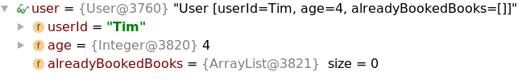
Library | Make scenario runnable
Glue code between steps and main code
DEV
@Given(“^the user from http://my.library.com/user/([^\”]*)$”)
public void given_the_user_from_ws(String userId, List<FieldValue> values) throws Throwable {
FieldValues fieldsValues = new FieldValues(values);
user.setUserId(userId);
user.setAge(fieldsValues.getAsInteger(field:”age”));
when(usersWSClientMock.retrieveUser(user.getUserId())).thenReturn(user);
}
Contextual variable
<number>

Slide 41
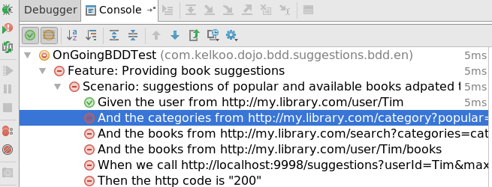
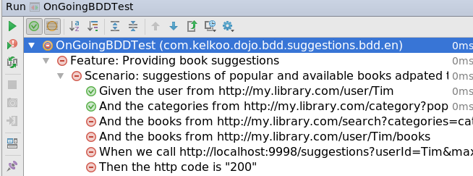
Library | Make scenario runnable
BDD
@level_2_technical_details @nominal_case @ongoing
Scenario: suggestions of popular and available books adapted to the age of the user,
he have never booked suggestions
Given the user from http://my.library.com/user/Tim
| field | value |
| userId | Tim |
| age | 4 |
And the categories from http://mt.library.com/category?popular=true&age=4
| categoryId | categoryName |
| cat1 | Walt Disney |
| cat2 | Picture book |
| cat3 | Bedtime stories |
And the books from http://mt.library.com/categories=cat1,cat2,cat3&available=true
| bookId | bookTitle | categoryId |
| b11 | Walt Disney | cat1 |
DEV
Define mocks behavior
<number>

Slide 42
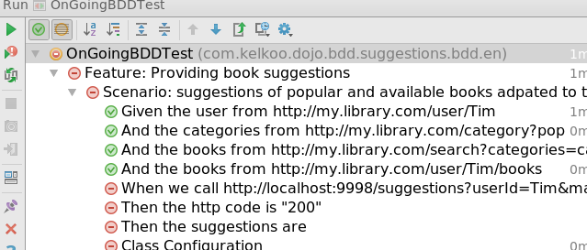
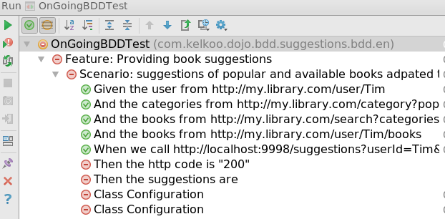
Library | Make scenario runnable
BDD
DEV
Main code call
<number>

Slide 43
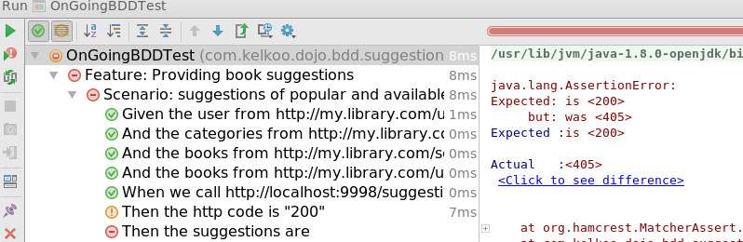
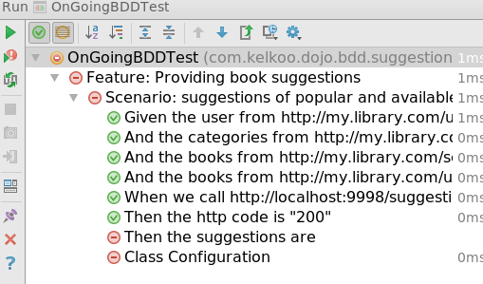
Library | Make scenario runnable
BDD
@Then(“^the http code is \”([^\”]*)\”$”)
public void the_http_code_is(Integer httpCode) throws Throwable {
assertThat(wsSuggestionsResponse.getStatus(), is(httpCode));
}
DEV
Main code does not exist…
Check results
<number>

Slide 44
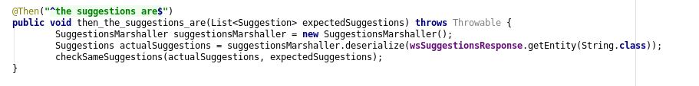
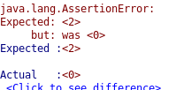
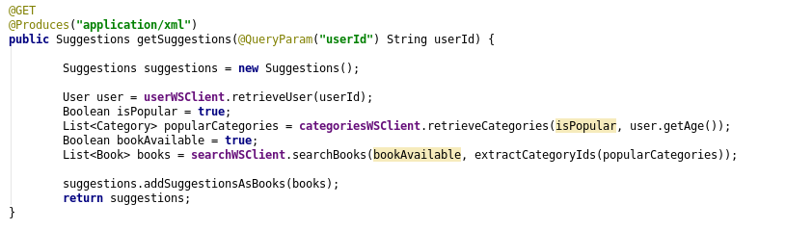
Library | Make scenario runnable
BDD
DEV
Let’s write the real code
<number>

Slide 45
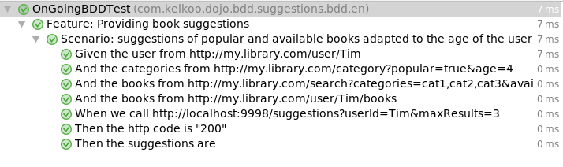
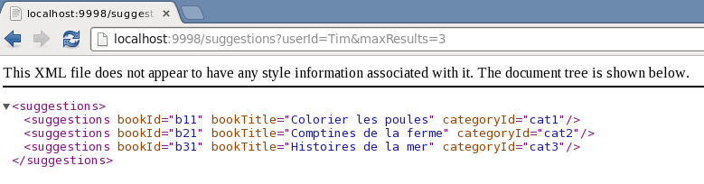
Library | Make scenario runnable
BDD
DEV
First implemented scenario!
The code is activated in the production conditions
<number>

Slide 46
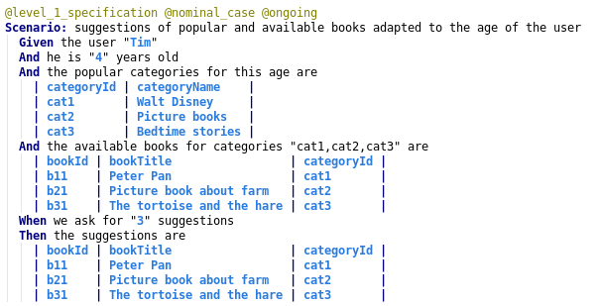
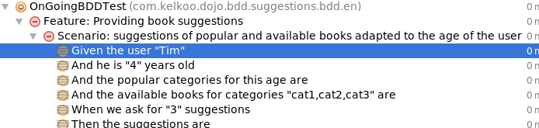
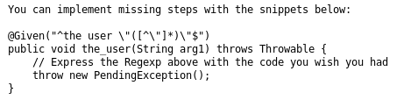
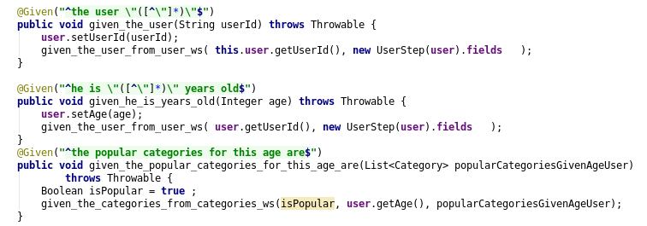
BDD
Library | Make scenario runnable
BDD
DEV
Reusing executable steps with a lower level of abstraction
<number>

Slide 47
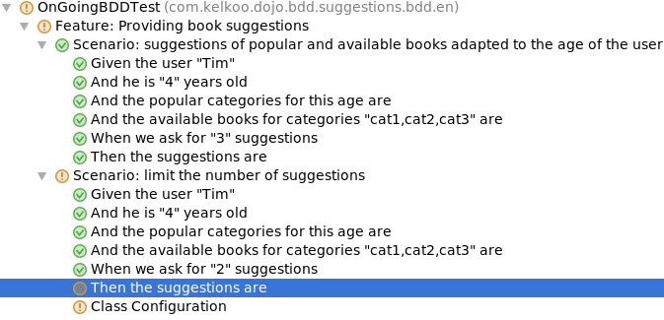
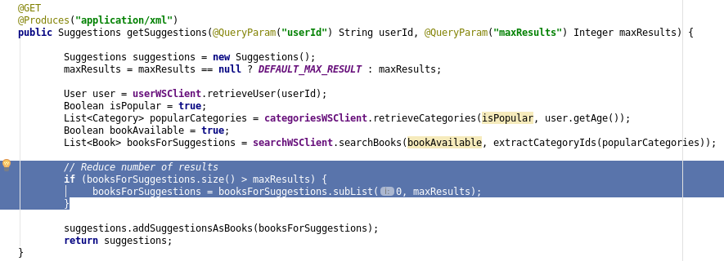
BDD
Library | Make scenario runnable
BDD
DEV
Reusing steps
<number>

Slide 48
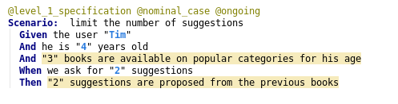
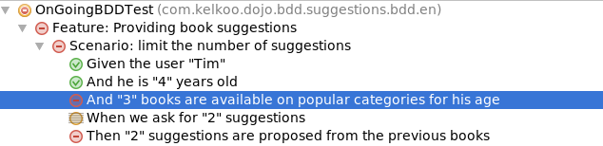
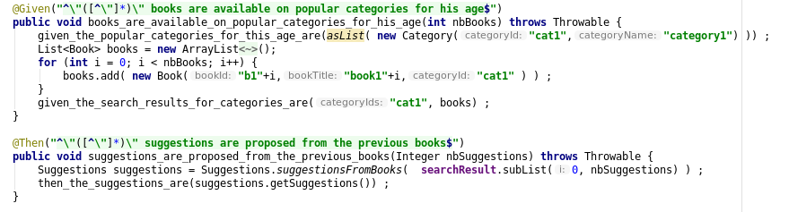
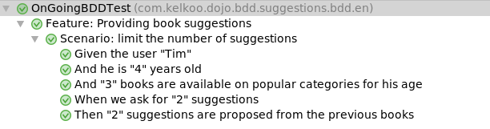
BDD
Library | Make scenario runnable
BDD
DEV
Generate data to make a scenario easier to read
<number>

Slide 49
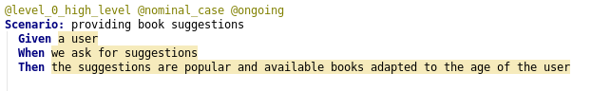
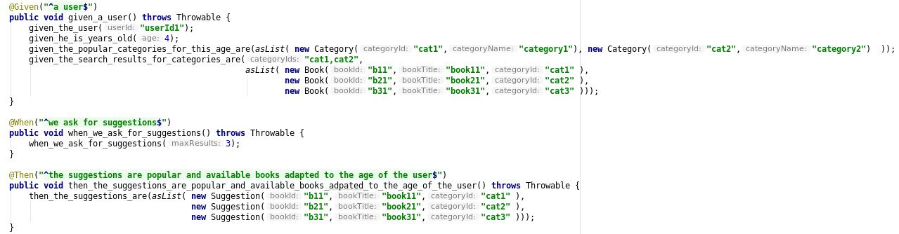
BDD
Library | Make scenario runnable
BDD
DEV
Implement a high level scenario
<number>

Slide 50
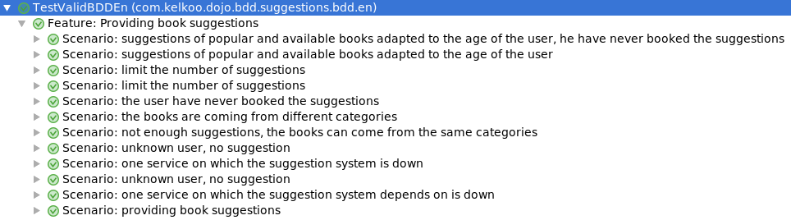
BDD
BDD
Library | Make scenario runnable
BDD
DEV
All scenarios are implemented
<number>

Slide 51
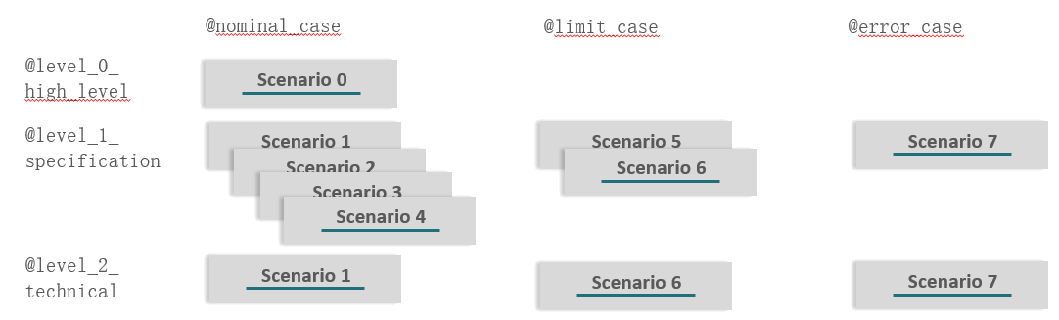
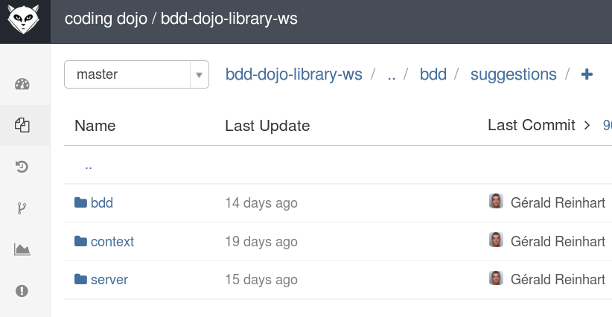
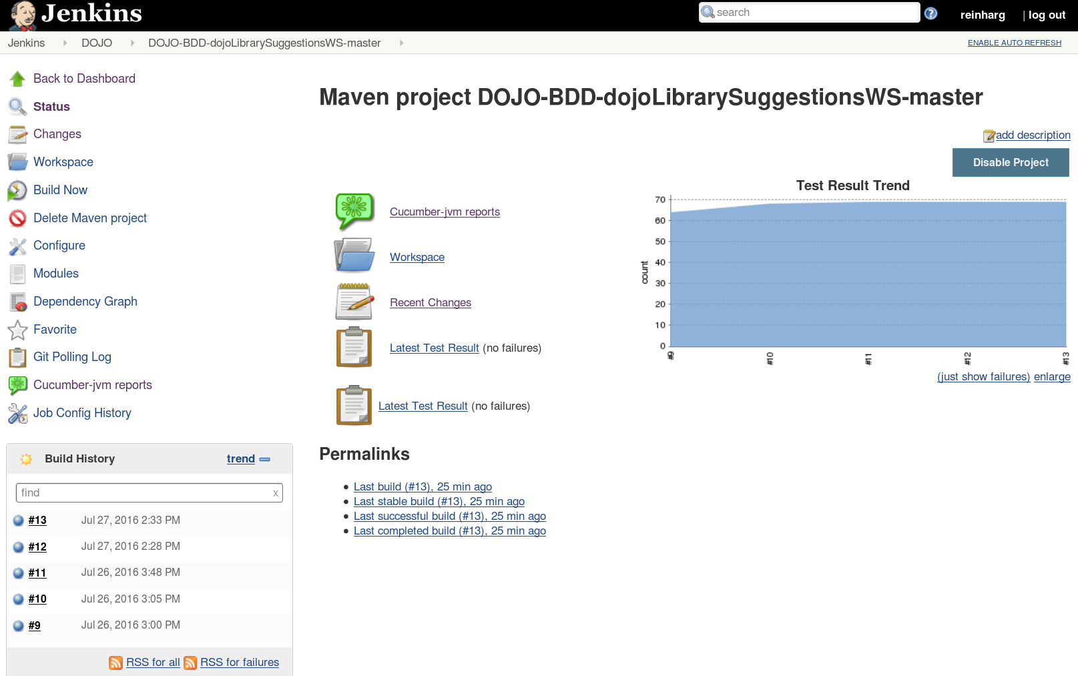
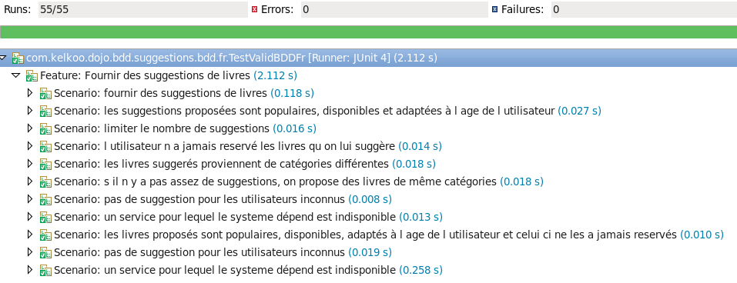
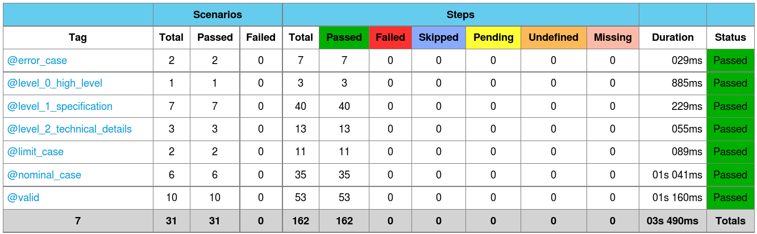
Library | Regression tests
Regular regression tests
DEV
Continuous
Integration
Scenarios BDD
Source Code
<number>

Slide 52
Improve the process
Emails
User Story
Acceptance Criteria
Write scenarios so that both PO and DEV can understand
PO
DEV
Wrote it
with DEV
Wrote it
with PO
Scenarios
Implementation based on
the scenarios
Difficult to access to the accurate documentation
Anyone
Reflect features in production
Code is driven by scenarios
Move to production
Production
Integration tests
<number>

Slide 53

Improve the process
User Story
Acceptance Criteria
Write scenarios so that both PO and DEV can understand
PO
DEV
Wrote it
with DEV
Wrote it
with PO
Scenarios
Implementation based on
the scenarios
Search / Navigate by BDD Web App
Anyone
Reflect features in production
Code is driven by scenarios
Move to production
Production
Integration tests
<number>

Slide 54
Conclusion
Specification by example
Close collaboration DEV / PO is required
Use examples to open discussion and find many cases
Allows a very fast feedback loop
Functional tests
Fast and stable tests
The developer is guided, the code is pulled by the tests
Flexible code is required to mock external interactions
Runnable Documentation
Pulled from code, the documentation is always up to date
The documentation is exhaustive
<number>

Slide 55
Conclusion
Specification by example
Close collaboration DEV / PO is required
Use examples to open discussion and find many cases
Allows a very fast feedback loop
Functional tests
Fast and stable tests
The developer is guided, the code is pulled by the tests
Flexible code is required to mock external interactions
Runnable Documentation
Pulled from code, the documentation is always up to date
The documentation is exhaustive
<number>

Slide 56
Conclusion
Failure factor
DEV or PO not involved
BDD applied during the project : need to be done a the very first step
theGardener aim is to address too important use cases not really addressed yet :
easily access to the scenario
collaborative tools to help PO and DEV discussion
=> https://github.com/KelkooGroup/theGardener/wiki
<number>

Slide 57
Thank you

